Slide 1
Example Cities

Slide 2
Tokyo-like
Residential
Residential & Commercial
Residential
Residential
(Rural)
Park
Park
Commercial & Residential
Commercial & Residential
Commercial
Park
Residential
(Grid)
Residential
(Quasi-Grid)
Buisiness
Park

Slide 3
Paris-like
Residential
Residential
(Rural)
Commercial
& Residential
Park
Residential
Commercial & Business
Rich people
Park
Residential
(Rural)
Residential
(City)
Residential
Residential
(City)
Residential
(Rural)
Park

Slide 4
Madrid-like
Park
Residence
New Residential
(Under Construction)
Air Port
Residence
(Rural)
Commercial
&
Residence
Commercial
&
Residence
(Rural)
Park
Residential
Business & Commercial
Commercial & Residential
New Residential
Forest
Residence
Residence
Residence
(Rural)
New Residential
(Under Construction)
Residence
(Rural)
Park
New Residential

Slide 5
１．Tokyo, Paris, Madridの道路を読込み、それを参考にしながら地形を作成する。
２．エリアを設定して保存する。
３．道路スタイルを適用して画像を保存する。
それぞれのスタイルの都市名と、その特徴（理由）を書く。

Slide 6
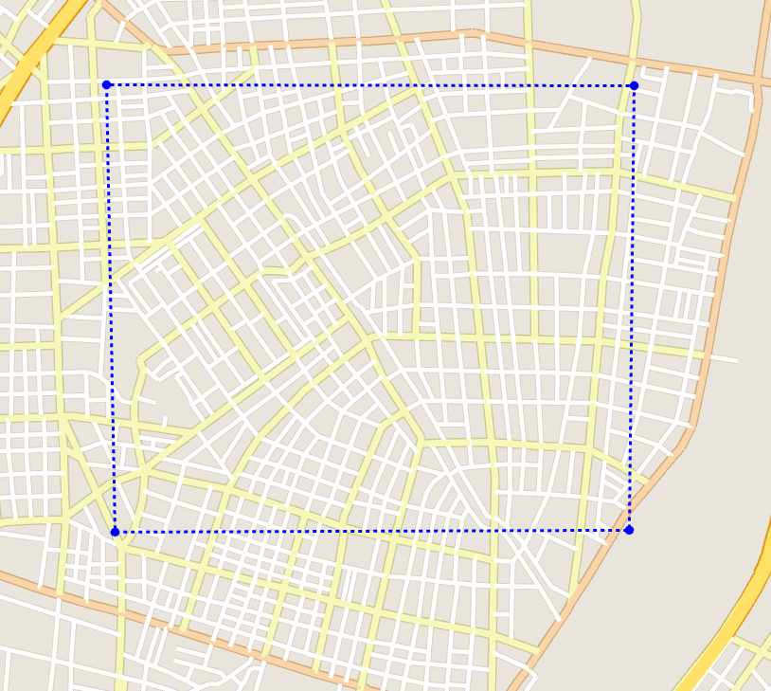
feature_tokyo_1.xml
Commercial & Residential

Slide 7
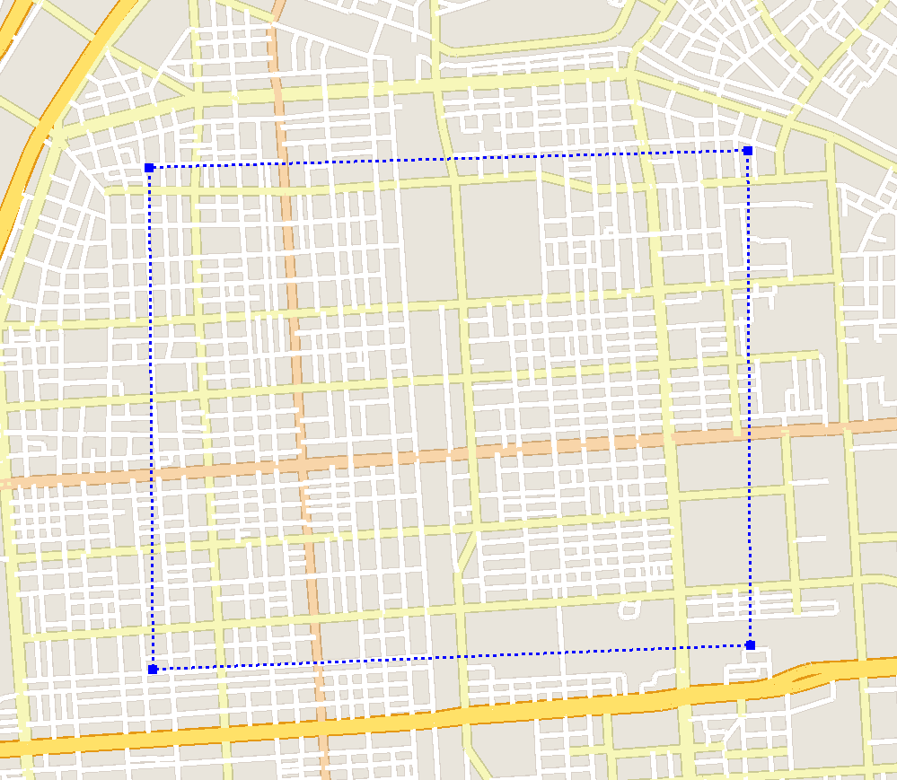
feature_tokyo_2.xml
Residential (Grid)

Slide 8
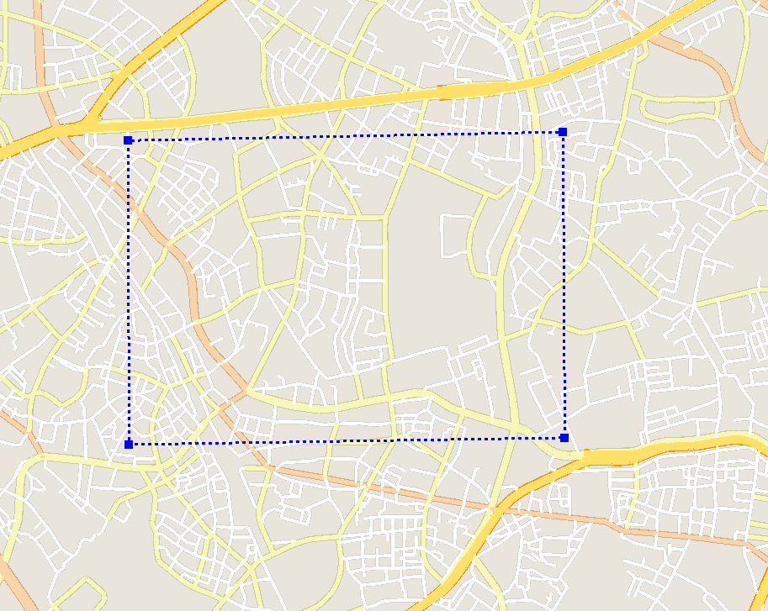
feature_tokyo_3.xml
Residential

Slide 9
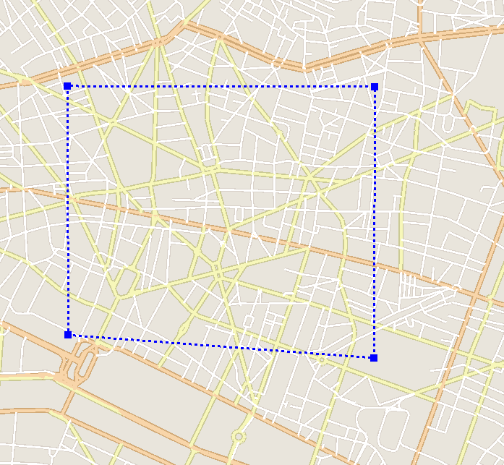
feature_paris_1.xml
Commercial & Business

Slide 10
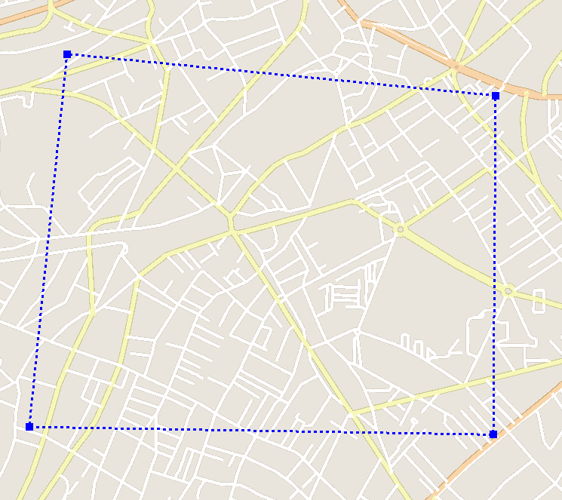
feature_paris_2.xml
Residential (City)

Slide 11
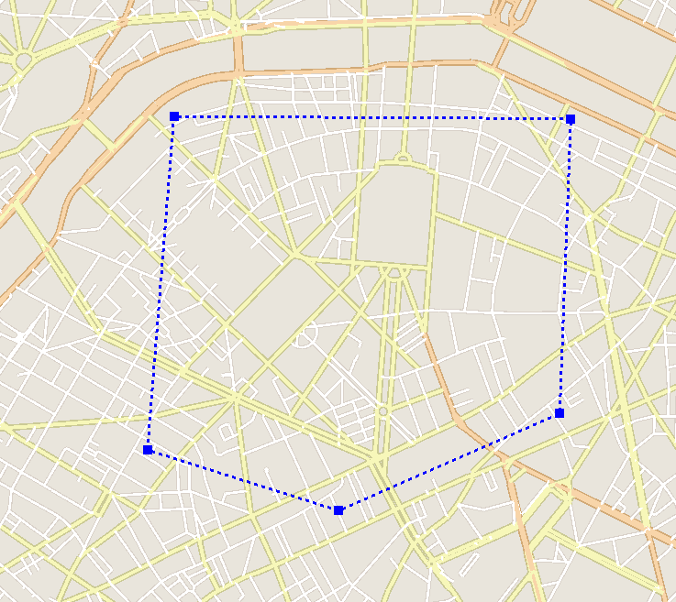
feature_paris_3.xml
Commercial & Business

Slide 12
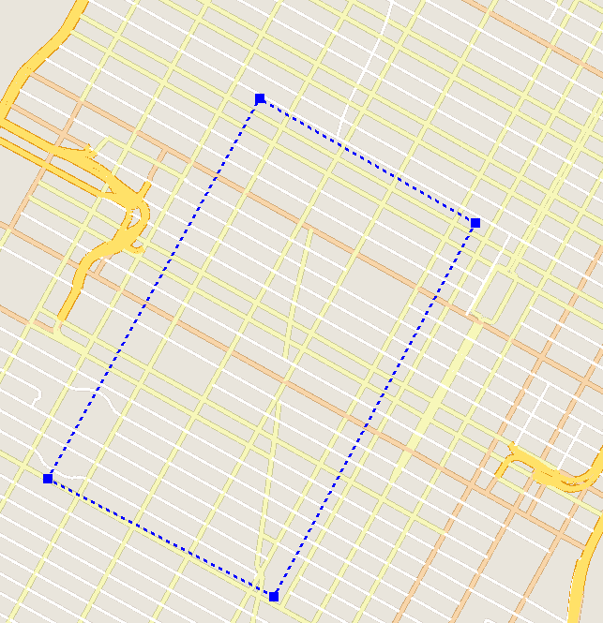
feature_new-york1.xml
Grid

Slide 13
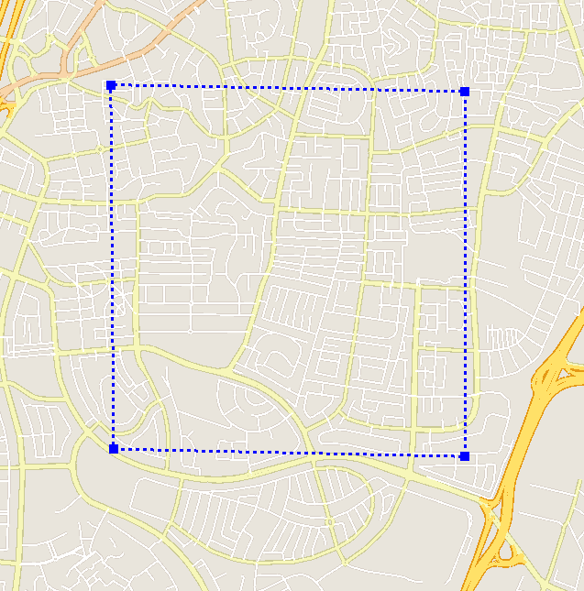
feature_tel-aviv1.xml
Residential

Slide 14
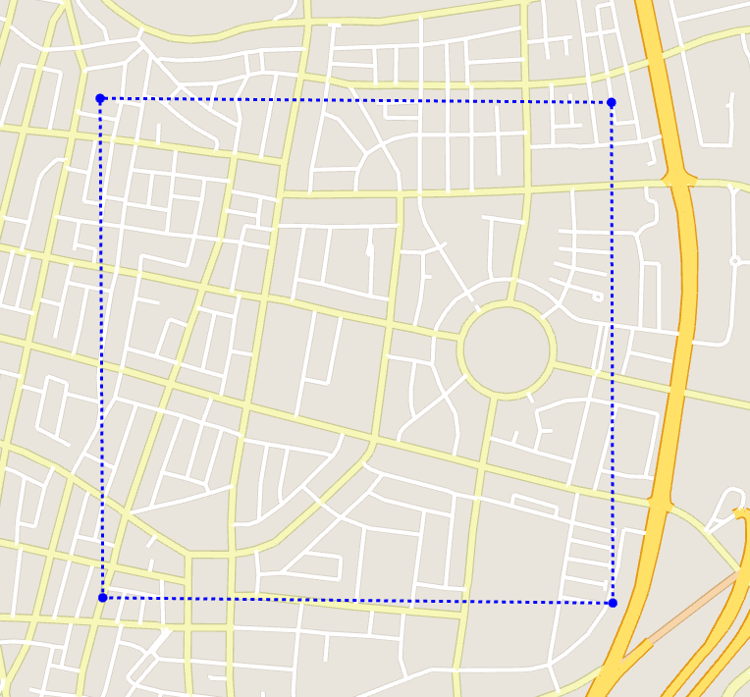
feature_tel-aviv2.xml
Business & Commercial
18
13
8
12
16
20
7
3
6
4
2
10
5
14
9
17
11
15
19
0
1

Slide 15
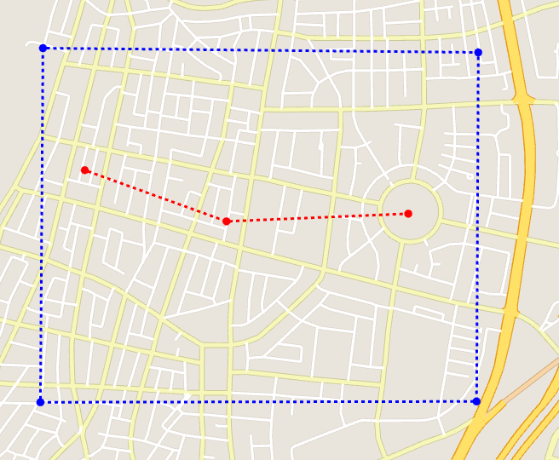
ex_feature_tel-aviv2.xml
0
2
1

Slide 16
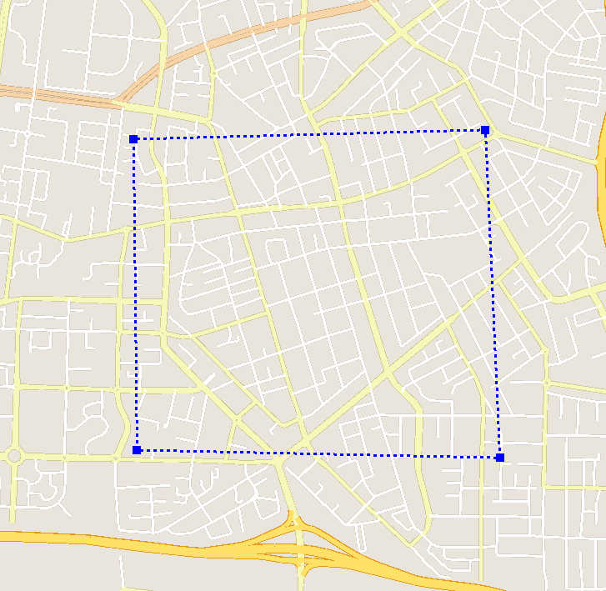
feature_tel-aviv3.xml
Residential

Slide 17
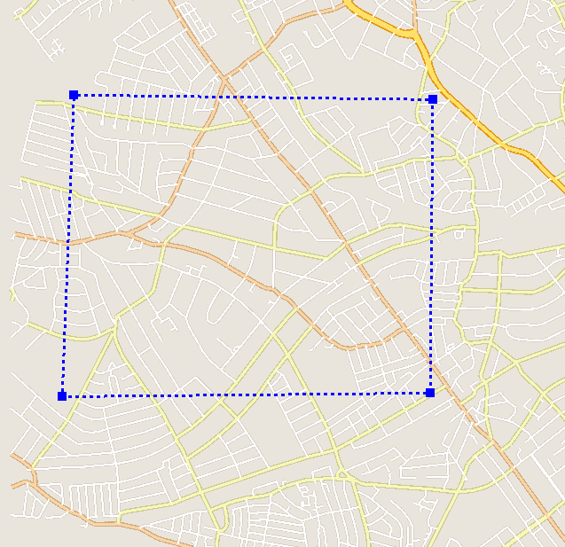
feature_london1.xml
Residential

Slide 18
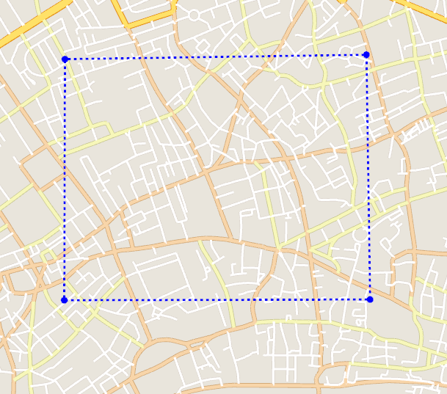
feature_london2.xml
Business & Commercial

Slide 19
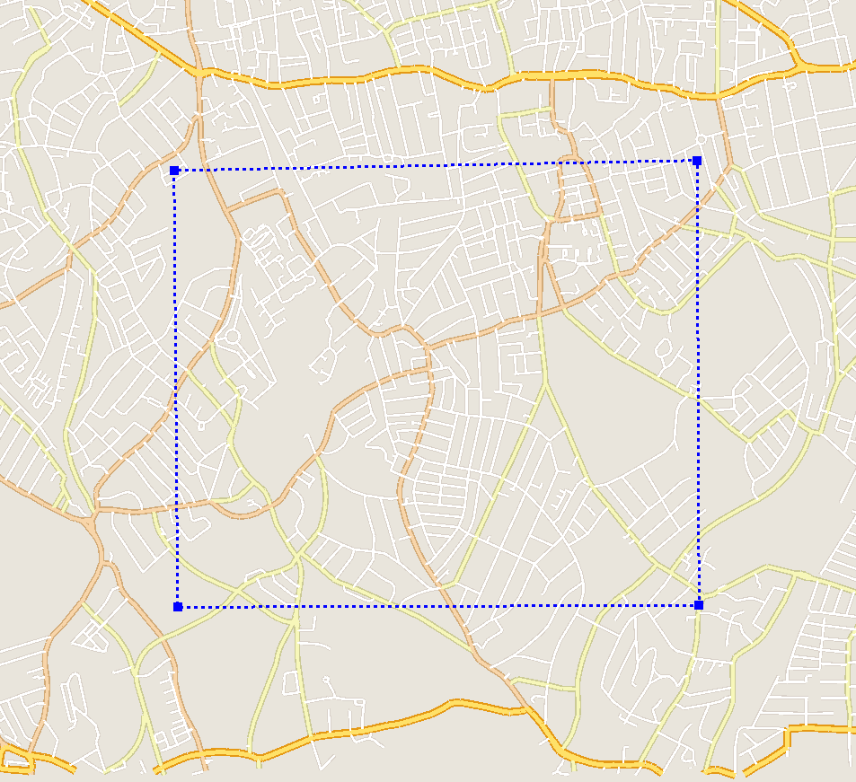
feature_london3.xml
Residential

Slide 20
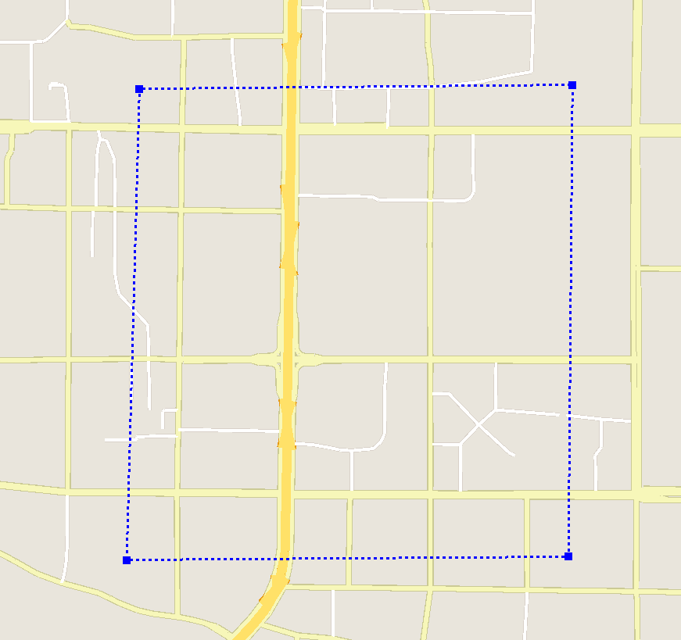
feature_beijing1.xml
Residential

Slide 21
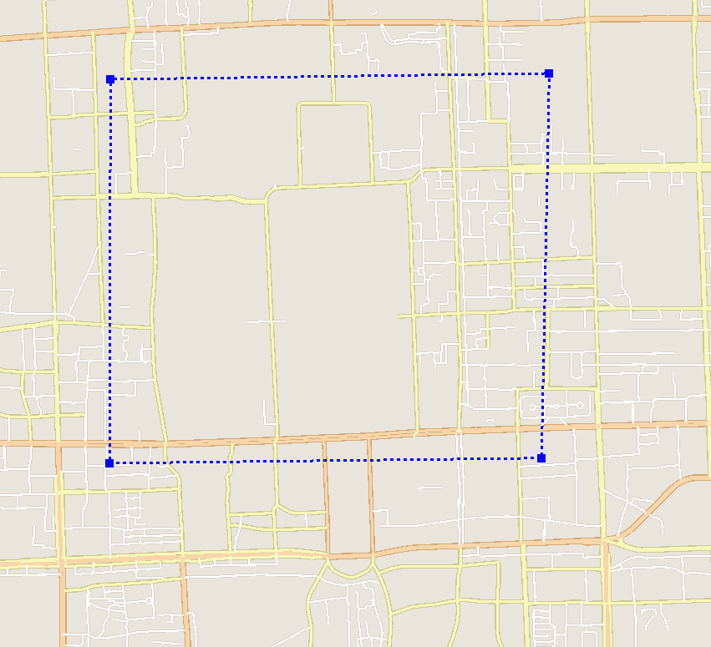
feature_beijing2.xml
Commercial

